Slide 1

ONLINE VOTING SYSTEM
GROUP MEMBERS
K . Mohan Sai
P . Rishikesh
E . Shyam Kumar
Ch . Nikhil
UNDER THE GUIDANCE OF
K . Kavitha Rani mam

Slide 2

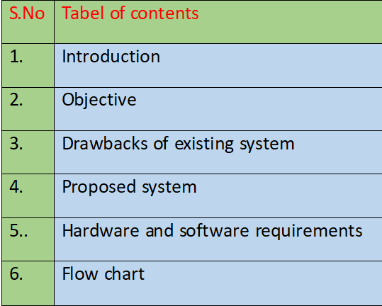

Slide 3


Introduction
"ONLINE VOTING SYSTEM" is an online voting technique.In
this system people who are citizens of a country and whose age is greater than 18 and any gender can give his/her vote online without going to any physical polling booths.
In this every eligible voter is provided with an unique id called voter id .By using this voter id they can access the online voting system.

Slide 4


Introduction
After entering the age of the user the system will check whether they are
eligible to vote or not .If they are eligible then they are required to enter the voter id and name after that they can cast there vote to thier favorite party.After voting is complete, the party with the most votes will be proclaimed the winner according to the online voting system.

Slide 5


Objectives
Implementing an automated online machine.
Validating the system to ensure that only legible voters are allowed to vote.
Reduce time for voters to cast their vote.

Slide 6

Existing system
1)Paper-based voting:-
The voter gets a blank ballot and use a pen or a marker to indicate he/she want to vote for which candicate.Hand-counted ballots is a time and labour consuming process,but it is easy to manufacture paper ballots and the ballots can be retained.
2)
optical voting machine :-
After each voter fills a circle corresponding to their favorite candidate on the blank ballot,this machine selects the darkest mark on each ballot for the vote then computes the total result.

Slide 7


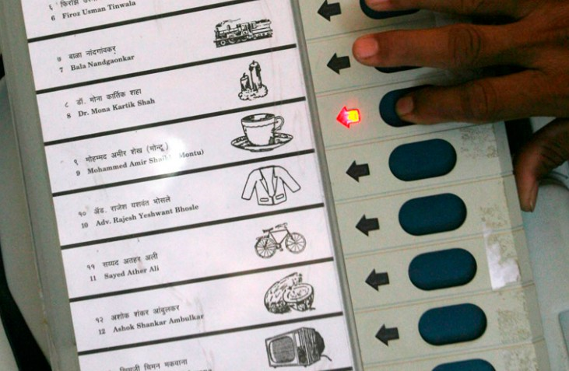
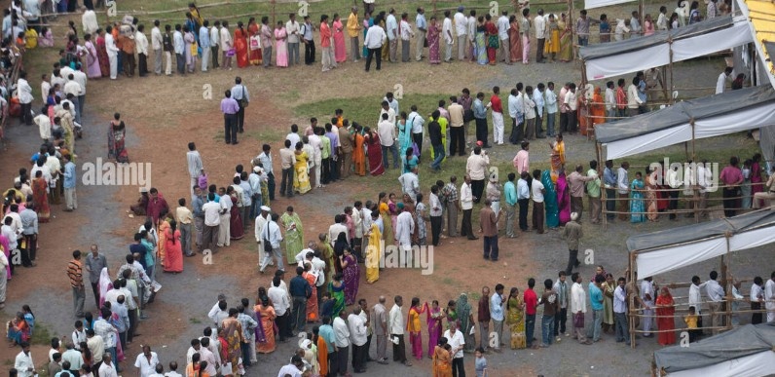
Drawbacks of an existing system
Need number of staff to conduct voting
Sometimes counting mistakes also happens during counting of votes.
Voters need to spend a lot of time in queue to cast their vote.

Slide 8

Need for new System
Now we need a new system to overcome all the above mentioned
drawbacks of present existing system like staff-free,any voter can easily handle the system,reduce the errors occured during counting
,paper-free,saves lot of time for voters.

Slide 9

Proposed system
Features of system:- 1.voters can cast their votes easily
2.secure and not eligible candicates cannot be able to vote 3.Error free
Counting does not take long time.
User requirements:
Age of a voter 2.Voter ID of user

Slide 10


Technologies used
Java with Java Development Kit(JDK) more than Version 7.0 installed IDE's like NetBeans,VS code,Eclipse(optional)
SYSTEM REQUIRMENTS
Minimum Hardware Requirements:
RAM : 6GB (minimum) Processor : intel I5 (minimum) Storage: 128GB
Minimum Software Requirements:
Required Operating systemlike Windows, Linux, or macOS etc;

Slide 11
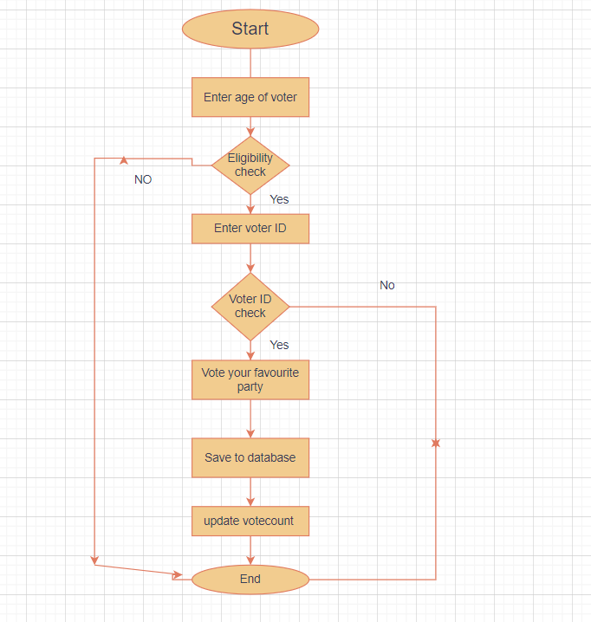






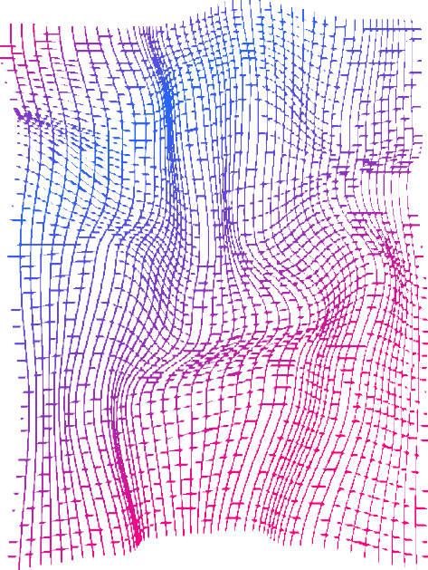
Flowchart

Slide 12
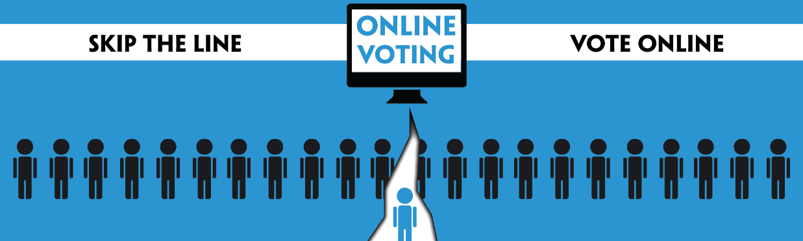
Thank You

